Slide 1
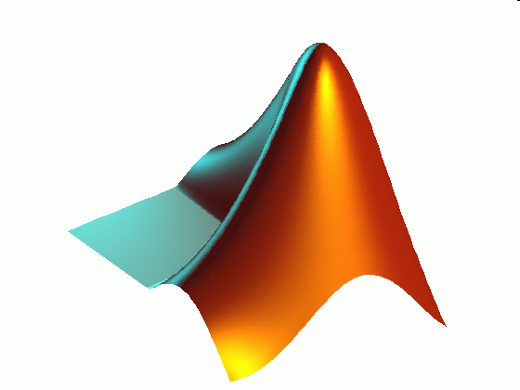
ME 203 Introduction to MATLAB
1

Slide 2
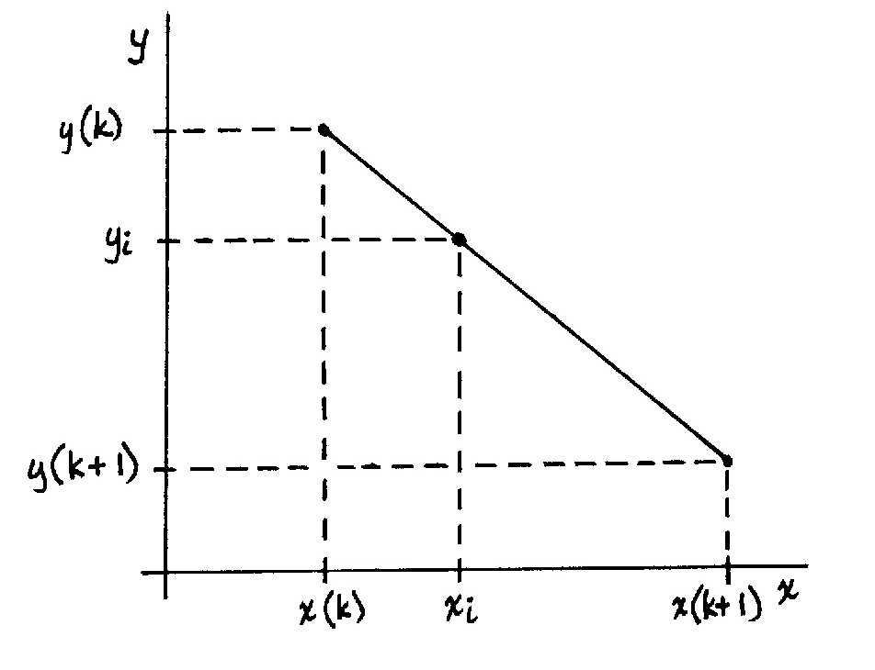

Interpolation
Interpolation is used to calculate a value between two data points
Assumes linear behavior between the two points
If you know two points (x_{k},y_{k})
and (x_{k+1},y_{k+1}) then you can use
a linear approximation to find
y_{i} at x_{i}
$$?$$

Slide 3
Interpolation
yi = interp1(x,y,xi)
Returns vector yi of the same length as xi, containing the interpolated
y values corresponding to xi using linear interpolation.
The vector x, which must have values in ascending order,
specifies the points at which the data y is given. Vectors x
and y must be of the same length. The values of xi must be
within the range of the x values.

Slide 4
Interpolation Example
Given the x and y data set below find y at x=2.6 and x=4.9.
x = 0:5;
y = [0 20 60 68 77 110];
Note: Check if the values of x_{i} are within the range of the x values

Slide 5
Interpolation Example
%Interpolation example 1
clc; clear; format compact
%Given
x = 0:5;
y = [0 20 60 68 77 110];
xi = [2.6, 4.9];
%calculations
yi = interp1(x, y, xi)

Slide 6
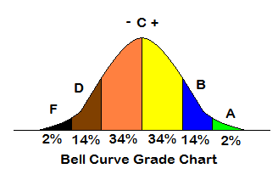
Normal (Gaussian) distribution

Slide 7
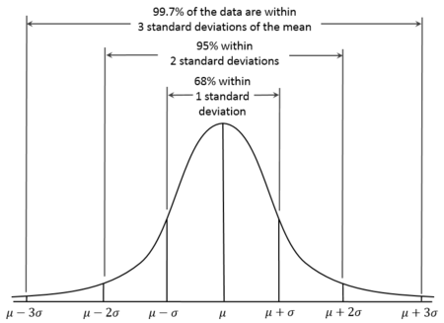

Normal distribution
$$μ: mean$$
$$σ: standard deviation$$

Slide 8
Normal distribution
mean(A) Returns the mean values of the elements of the vector A
std(A) Returns the sample standard deviation of the elements of the vector A
variance = (standard deviation)^2
var(A) Returns the variance of the elements of the vector A
A = [1 2 3 3 3 6 4 6 8 4 7 7];
d = std(A)
v1 = var(A)
v2 = d^2
d =
2.2361
v1 =
5
v2 =
5.0000

Slide 9
Uniformly Distributed Random Numbers
rand Returns a scalar in the interval (0,1) whose value changes each time it is referenced
rand(n) Returns an n×n matrix of random numbers distributed uniformly in the interval (0,1)
rand(m,n) Returns an m×n matrix of random numbers distributed uniformly in the interval (0,1)
Example
>> rand ans =
0.3474
>> rand(2) ans =
0.6606 0.6273
0.3839 0.0216
>> rand(2,3) ans =
0.9106 0.7458 0.3833
0.8006 0.8131 0.6173

Slide 10
Example: Uniformly Distributed Random Number
Using rand write a statement to store 3 random numbers between 5 and 15 in a row array A
Generate three random numbers between 0 and 1: rand(1,3)
Generate three random numbers between 0 and 10: 10*rand(1,3)
Generate three random numbers between 5 and 15:
A = 10*rand(1,3) +5

Slide 11
Normally Distributed Random Numbers
randn Returns a scalar whose value changes each time it is referenced
randn(n) Returns an n×n matrix of Gaussian random numbers with a mean of 0 and a standard deviation of 1
randn(m,n) Returns an m×n matrix of Gaussian random numbers with a mean of 0 and a standard deviation of 1
Example
>> randn ans =
0.2442
>> randn(2) ans =
0.0964 -0.3523
-0.8305 -0.1748
>> randn(2,3) ans =
-0.4807 2.5383 0.1283
0.8368 -1.3233 -1.4424

Slide 12
Example: Normally Distributed Random Number
The height of males in the United States is normally distributed with mean 1.763 m and standard deviation of 0.0762 m.
Using randn, generate a row vector of random heights (in meters) for 6 males and assign it to a variable A

Slide 13
Flipping a Coin Example
When a fair coin is flipped, the probability of getting heads or tails is 0.5 (50%).
Tails =0 Heads =1
Generate a uniform random number in the range and use an appropriate rounding function so all the answers are either 0 or 1.
Simulate flipping the coin 50 times and plot the results in a histogram
Which function should you use to generate the flips?
rand vs randn
Which function should you use for rounding?
round, floor, ceil or fix

Slide 14
Example: Rand function
Choose rand because it is between 0 and 1 (no negative numbers)
Test with 8 values first
n=8;
a=rand(1,n)
a =
0.7295 0.2243 0.2691 0.6730 0.4775 0.6237 0.2364 0.1771
round(a)
ans =
1 0 0 1 0 1 0 0
Row vector length n

Slide 15
Example:
Rand function and floor function
a=rand(1,n)
a =
0.7295 0.2243 0.2691 0.6730 0.4775 0.6237 0.2364 0.1771
>> floor(a)
ans =
0 0 0 0 0 0 0 0
>> 2*a
ans =
1.4590 0.4486 0.5381 1.3461 0.9550 1.2474 0.4729 0.3542
floor(2*a)
ans =
1 0 0 1 0 1 0 0

Slide 16
Example:
Rand function and ceil function
a=rand(1,n)
a =
0.7295 0.2243 0.2691 0.6730 0.4775 0.6237 0.2364 0.1771
ceil(a) ans =
1 1 1 1 1 1 1 1
ceil(2*a) ans =
2 1 1 2 1 2 1 1
ceil(2*a-1) ans =
1 0 0 1 0 1 0 0
ceil(2*a)-1 ans =
1 0 0 1 0 1 0 0

Slide 17
Example:
Rand function and fix function
a=rand(1,n)
a =
0.7295 0.2243 0.2691 0.6730 0.4775 0.6237 0.2364 0.1771
fix(a)
ans =
0 0 0 0 0 0 0 0
>> fix(2*a)
ans =
1 0 0 1 0 1 0 0

Slide 18
Example: Rand function comparison
a =
0.7295 0.2243 0.2691 0.6730 0.4775 0.6237 0.2364 0.1771
Round: 1 0 0 1 0 1 0 0
Floor: 1 0 0 1 0 1 0 0
Ceil: 1 0 0 1 0 1 0 0
Fix: 1 0 0 1 0 1 0 0

Slide 19
Example: Randn function
Can we make randn work?
b=randn(1,8)
b =
0.7612 1.1933 1.6321 -1.5322 -1.3369 -1.4738 -0.0417 -0.6155
fix(abs(randn(1,8)))
ans =
0 0 0 1 0 0 1 0
Does it physically make sense to choose this method even though it works?

Slide 20
Example: Plot Results
%Coin flipping simulation
%Coin flip
n = 50; % number of flips
coin = round(rand(1,n)) % vector of n flips: 0-tails, 1-heads
%Histogram
xc = [0, 1]; %histogram centers
y = hist(coin, xc) %absolute frequency
bar(xc, y)
xlabel('0: tails, 1: heads')
ylabel('frequency')
title('Absolute frequency histogram for 50 coin flips')

Slide 21
Noisy signal simulation
To extract useful information from experimental data it often needs to be manipulated which may include filters
Before testing the post processing calculations on the on actual data it is a good idea to test it on a known data set to make sure it is working correctly
Let’s use Matlab to generate a random signal that we can use to test common experimental data calculations

Slide 22
Ex: Noisy signal simulation
Create a noisy signal that is 10 sec long and has 512 data points. The an amplitude of the underlying signal is 1 and has a frequency of 2*pi/5. The amplitude of the noise is 0.1. plot the noisy signal.

Slide 23
Ex: Noisy signal simulation

Slide 24
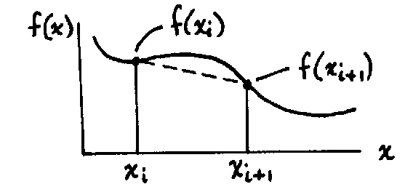
Integration
There are many integration methods in MATLAB. We are only going to look at a few of them. The rest of the functions in Matlab work similarly.
Single Integrals
Trapezoidal Rule – calculates the area under the curve by dividing the range into a series of points and connecting each point using a straight line

Slide 25
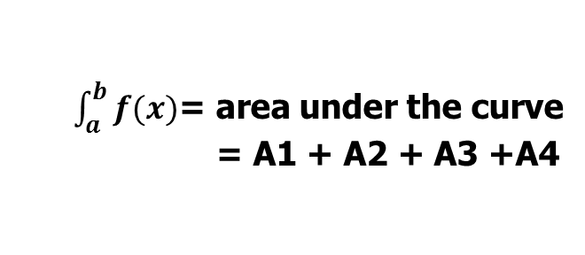
Trapezoidal Rule
f (x)
$\int_{a}^{b}{f(x)}$= area under the curve
= A1 + A2 + A3 +A4
A1
A2
A3
A4
x
a
b

Slide 26
Trapezoidal Numerical Integration
z = trapz(x,y) Integral of y with respect to x by the trapezoidal rule. x and y must be vectors of the same length, or x must be a column vector and y an array whose first non- singleton dimension is length(x). trapz operates along this dimension.
z = cumtrapz(x,y) Computes the cumulative integral of y with respect to x using trapezoidal integration. x and y must be vectors of the same length, or x must be a column vector and y an array whose first non-singleton dimension is length(x). cumtrapz operates across this dimension.

Slide 27
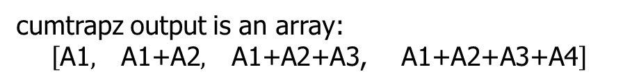
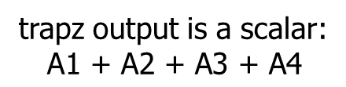
Trapezoidal Rule
trapz output is a scalar:
$$\text{A}\text{1 + }\text{A}\text{2 + }\text{A}\text{3 + }\text{A}\text{4}$$
f (x)
cumtrapz output is an array:
$$\left[\begin{matrix}\text{A}\text{1}, & \begin{matrix}\text{A}\text{1+}\text{A}\text{2}, & \begin{matrix}\text{A}\text{1+}\text{A}\text{2+}\text{A}\text{3, } & \text{A}\text{1+}\text{A}\text{2+}\text{A}\text{3}\text{+}\text{A}\text{4}\end{matrix}\end{matrix}\end{matrix}\right]$$
A1
A2
A3
A4
x
a
b

Slide 28

Example 1
Calculate the integral of sin(x) in the interval [0,$π$] (exact solution is 2)
% Integral example 1
clc; clear all; format compact
%x range
x = linspace(0,pi,100);
%function
y=sin(x);
%calculate integral
z=trapz(x,y)
Result
z =
1.9998

Slide 29

Example 2
Calculate the integral of sin(x) in the interval [0,$π$]. Plot the function and its integral over the range of x.
% Integral example 2
clc; clear all; format compact
%x range
x = linspace(0,pi,100);
%function
y=sin(x);
%calculate integral
z=cumtrapz(x,y);
%plot results
plot(x,y,x,z)
xlabel('x')
legend('sin(x)','\intsin(x)')

Slide 30

Example 3
Calculate the integral of sin(x) in the interval [0,$π$]. Plot the function and its integral over the range of x. You cannot use cumtrapz.
% Integral example 3
clc; clear all; format compact
%x range
x = linspace(0,pi,100);
%function
y=sin(x);

Slide 31
Example 3 (continued)
z=zeros(1,100);
%calculate integral
for i=2:100
z(i) = trapz(x(1:i),y(1:i));
end
%plot results
plot(x,y,x,z)
xlabel('x')
legend('sin(x)','\intsin(x)')

Slide 32
Single Integrals – Alternative method
q = integral (function,xmin,xmax)
Example: Calculate the integral of [sin(x) + cos(x)] in the interval [0,$π$]
(exact solution = 2)
% Integral example 1
clc; clear all; format compact
%given
xmin = 0; xmax = pi;
%function handle
F = @(x) sin(x)+cos(x);
%calculate integral
q = integral (F, xmin, xmax)
Result
q =
2

Slide 33
Multiple Integrals
Matlab Function for Double Integrals
q = integral2 (function, xmin, xmax, ymin, ymax)
Matlab Function for Triple Integrals
q = integral3(function, xmin, xmax, ymin, ymax, zmin, zmax)

